Slide 1
Welcome
to the presentation on
PM Internship Scheme

Slide 2
Introduction
The PM Internship Scheme has been introduced to provide valuable work experience to young people in India. This initiative aims to bridge the gap between education and employment, helping students gain practical skills that are crucial for their future careers.

Slide 3
Basic Details
Announced in Budget 2024-25.
Aims to provide internship opportunities to one crore youth in top 500 companies in five years.
Scheme began with a pilot project for the financial year 2024-25, targeting 1.25 lakh internships.
internships span 24 sectors, including oil, gas, energy, travel, hospitality, automotive, banking, and financial services.
Internship Duration : 12 months.

Slide 4
Salient Features
Internship Duration : 12 months.
At least half of the internship period must be spent in actual working environment , not in the classroom.
₹5,000 monthly stipend (500 from company and 4500 from Government.)
One-time payment of ₹6,000
Gain real-life work experience

Slide 5
Eligibility criteria for candidates
Age : 21 to 24 years.
Educational Qualification : 10th , 12th, ITI, Diploma, Graduation.

Slide 6
Ineligibility criteria
Graduates from IITs,IIMs,National Law Universities, IISER, NIDs and IIITs.
Those having qualifications such as CA, CMA, CS, MBBS, BDS, MBA, any master’s or higher degree.
Those undergoing any skill, apprenticeship, internship or student training programme under central or state Govt. scheme.
Those who have completed apprenticeship training under NAPS or NATS at any point.
Income of any of the family member exceeds Rs. 8 Lakh for financial year 2023-24.
If any member of the family is a permanent / regular govt. employee.

Slide 7
Partner Companies
Reliance Industries Limited.
Tata Consultancy Services Limited.
HDFC Bank Limited.
Oil and Natural Gas Corporation Limited.
NTPC Limited.
Infosys Limited.
Tata Steel Limited.
ITC Limited.
Indian Oil Corporation Limited.
Wipro Limited etc.

Slide 8
Internship Opportunities by Education Level
Sr. No. | Education Level | No. of Opportunities in Country | No. of Opportunities in Himachal Pradesh
1 | 10th | 31,500 | 158
2 | 12th | 8,826 | 40
3 | ITI | 30,448 | 621
4 | Diploma | 21,222 | 155
5 | Graduate | 35,063 | 249
Total |  | 1,27,059 | 1,223

Slide 9
Internship Opportunities
District Wise
Sr. No | District Name | 10th | 12th | ITI | Diploma | Graduation
1 | Bilaspur | 10 | 0 | 79 | 20 | 5
2 | Chamba | 2 | 0 | 73 | 12 | 105
3 | Hamirpur | 10 | 0 | 05 | 01 | 02
4 | Kangra | 16 | 2 | 4 | 6 | 9
5 | Kinnour | 1 | 0 | 0 | 10 | 0
6 | Kullu | 7 | 0 | 133 | 32 | 18
7 | Laho ul & Spiti | 1 | 0 | 0 | 0 | 0
8 | Mandi | 8 | 0 | 22 | 2 | 35
9 | Shimla | 27 | 15 | 135 | 27 | 41
10 | Sirmour | 3 | 0 | 8 | 2 | 1
11 | Solan | 134 | 34 | 82 | 65 | 51
12 | Una | 65 | 0 | 3 | 1 | 15

Slide 10
State wise progress
State | Opportunities | Applicants | Selection | Acceptance | Joining
Andhra Pradesh | 4906 | 17371 | 3469 | 1149 | 231
Assam | 3523 | 7384 | 3523 | 1685 | 971
Bihar | 2820 | 12494 | 3175 | 1518 | 540
Chhattisgarh | 3326 | 4186 | 2040 | 755 | 217
Maharashtra | 14689 | 7332 | 6648 | 1826 | 515
Delhi | 3543 | 5682 | 3058 | 1164 | 376
Gujarat | 12246 | 6510 | 6176 | 1534 | 307
Haryana | 8232 | 13381 | 5779 | 1320 | 284
Himachal Pradesh | 1223 | 1210 (3630) | 1073 | 226 | 70

Slide 11
PM Internship Scheme phase 2
Registration was open for the 2nd phase of the scheme from 11/01/2025 to 27/01/2025.
380 candidates were registered from Technical Education Department.
Date to register has been extended by 15 days .

Slide 12

PM Internship scheme
Registration Process

Slide 13
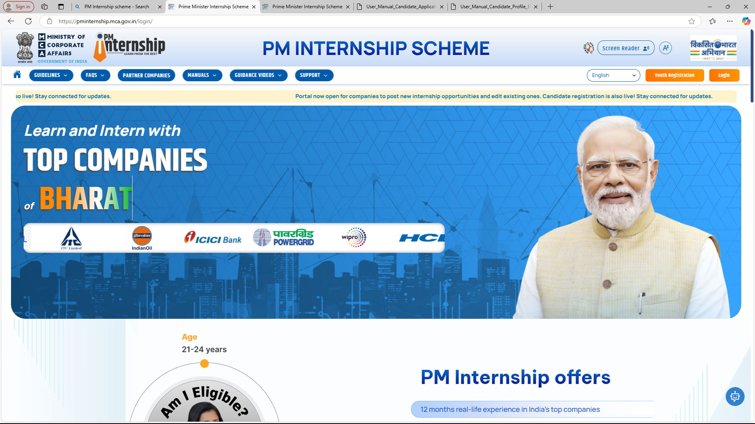
Go to the given URL https://pminternship.mca.gov.in/login/

Slide 14
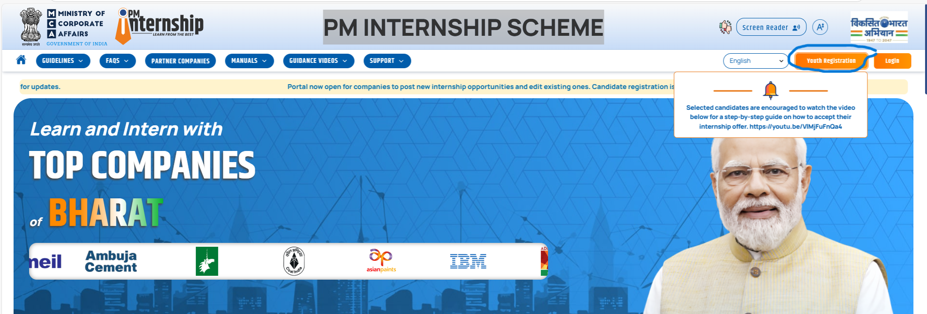
Click on Youth Registration

Slide 15
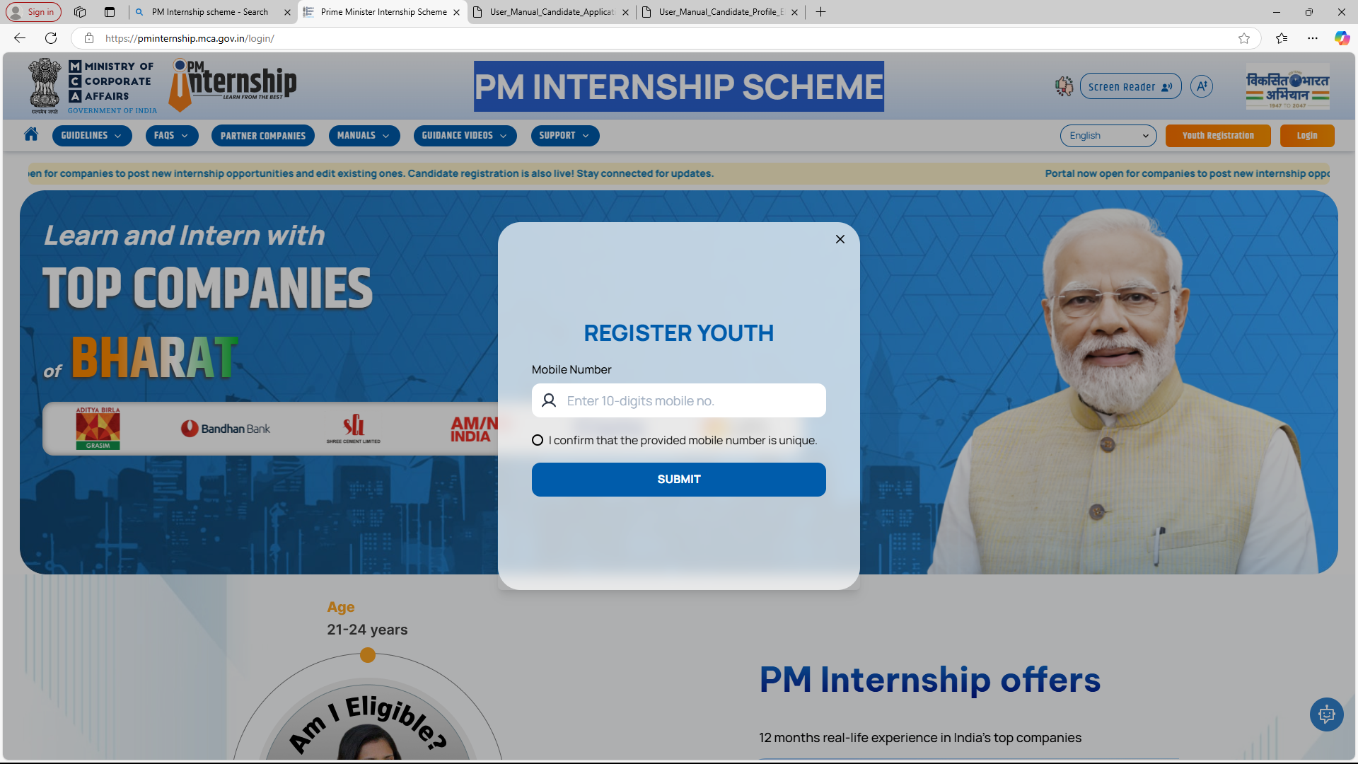
Enter 10 Digit Mobile Number

Slide 16
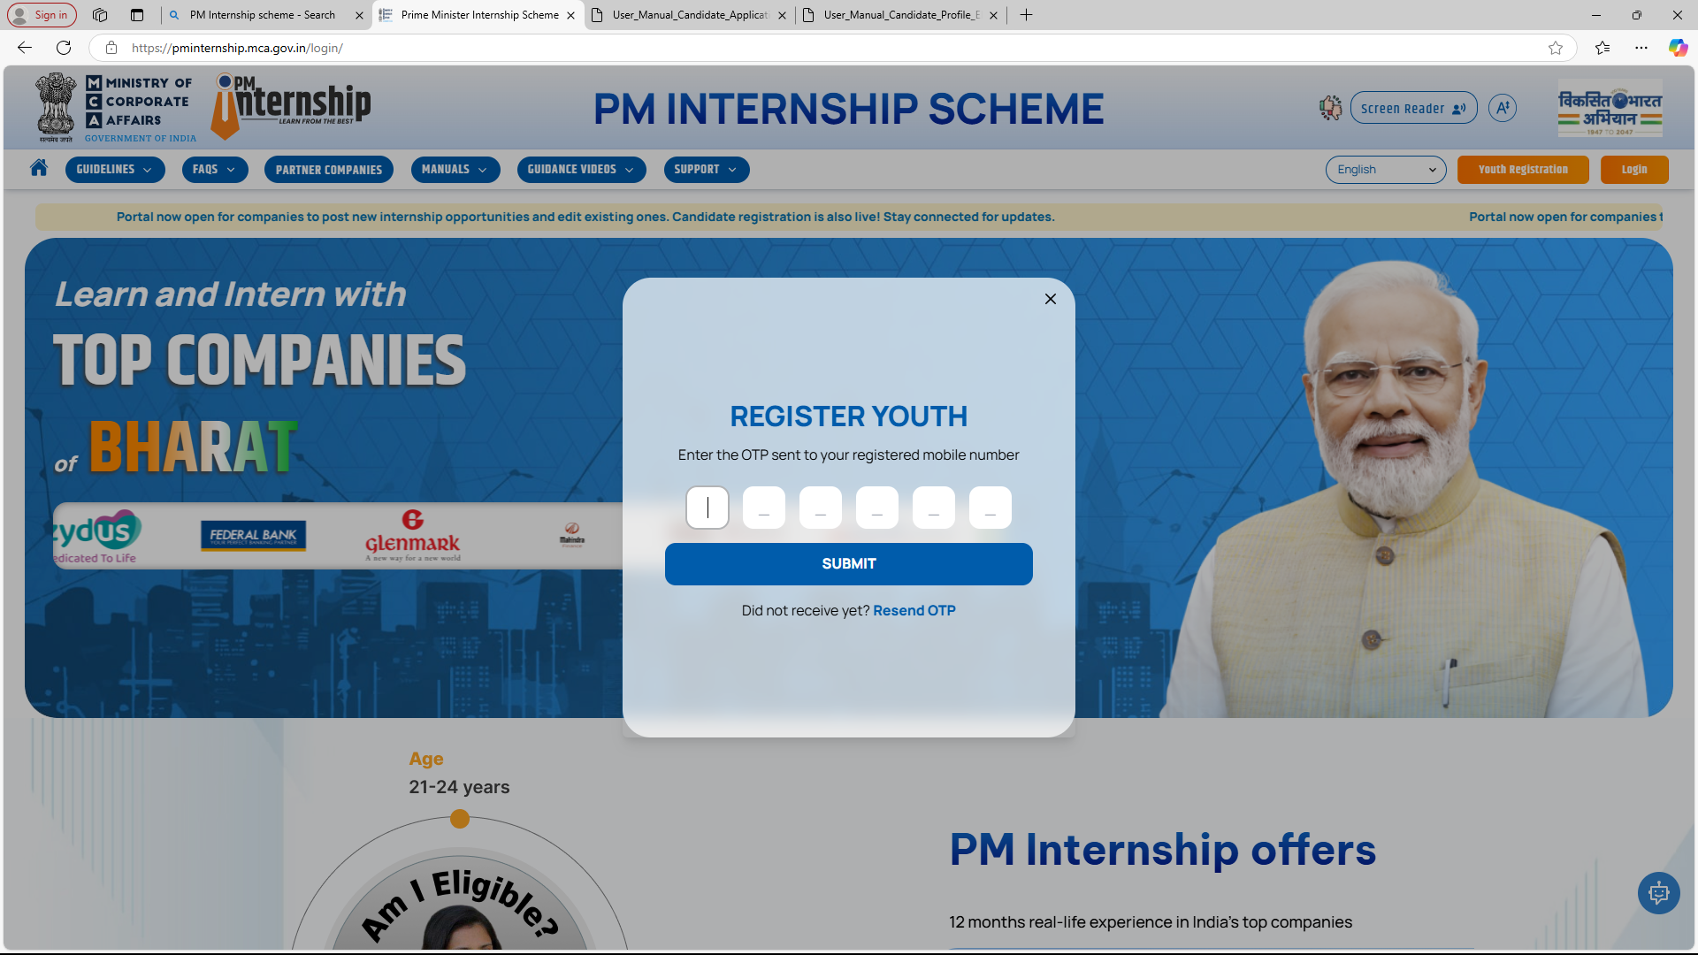
Enter OTP Received in your Number

Slide 17
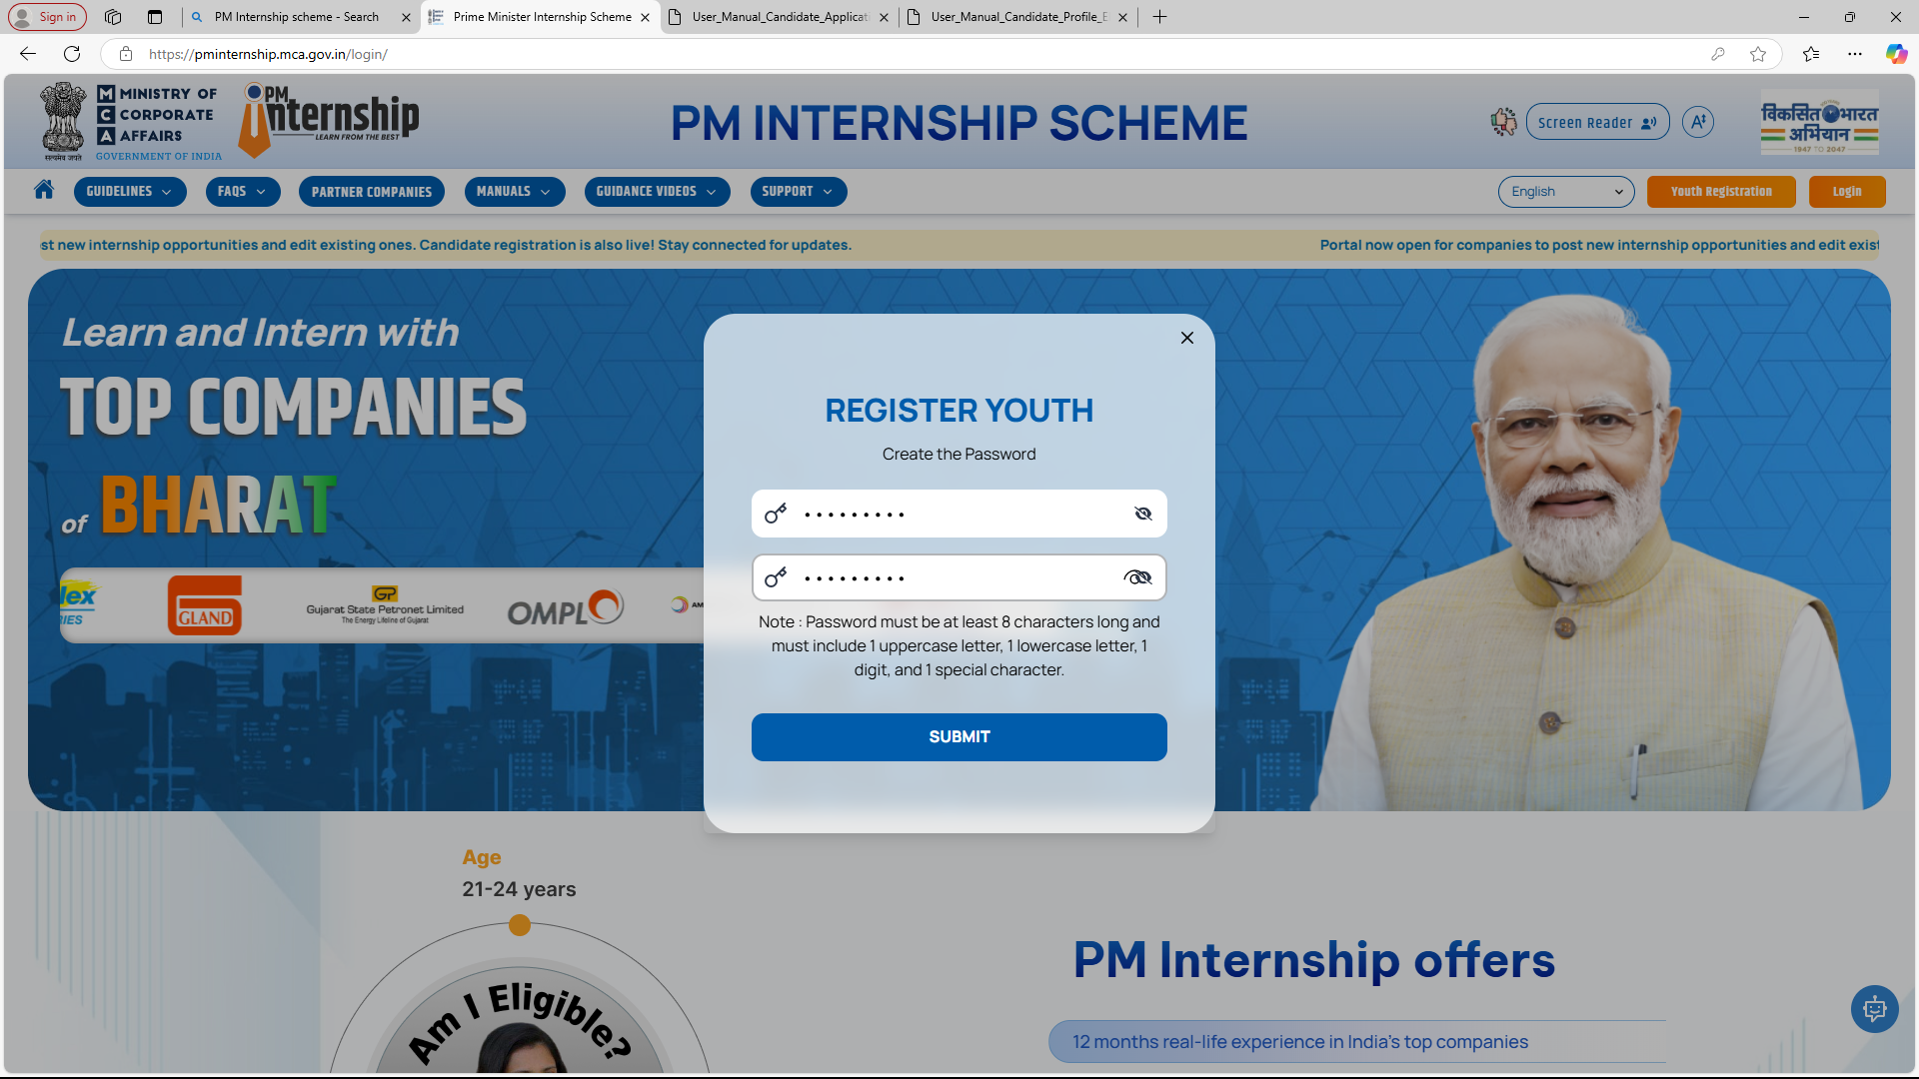
Create your Password and Submit

Slide 18
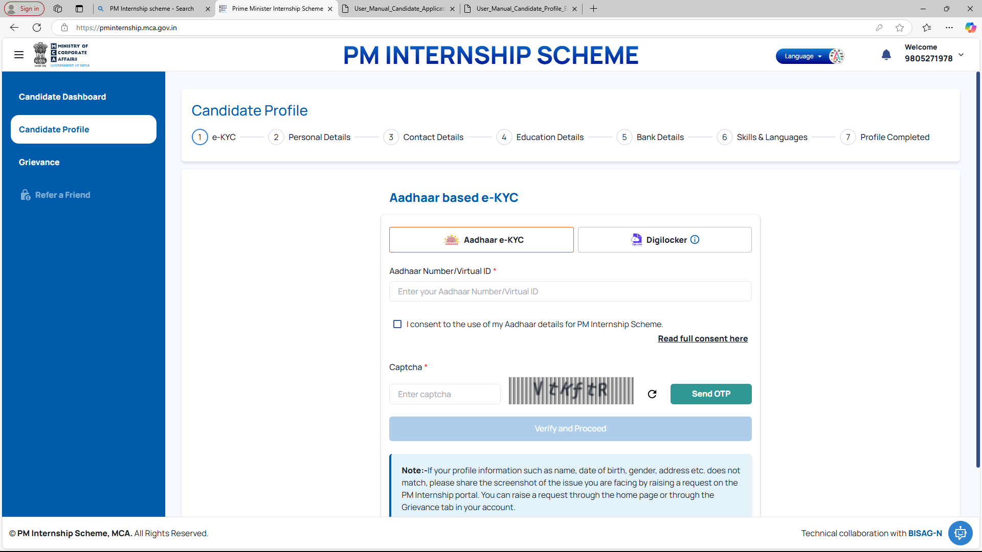
Complete the Profile

Slide 19
Thank You

